Slide 1
Analysis of 2024 Election Data using Power BI
Mentorness Internship Project
By Jinu J Kester
Batch – MIP-DA-11

Slide 2
Objective
The objective of this task is to analyze the 2024 election data to gain insights into the election results, party performance, and voter trends across various constituencies. In this project I have used Power BI to create interactive visualizations and dashboards that will help stakeholders understand the election outcomes and the dynamics between different political alliances.

Slide 3
Data Description:
2. Election Results Data:
`id`: Unique identifier for each record
`State`: Name of the state.
`Const. No.`: Constituency number.
`Constituency`: Name of the constituency.
`Leading Candidate`: Name of the leading candidate.
`Leading Party`: Name of the leading party.
`Trailing Candidate`: Name of the trailing candidate.
`Trailing Party`: Name of the trailing party.
`Margin`: Vote margin between the leading and trailing candidates.
`Status`: Status of the election result (e.g., Won, Lost, Leading, Trailing).
2. Party Alliance Data:
`Party Name`: Name of the political party.
`Alliance Name`: Name of the political alliance the party belongs to.

Slide 4
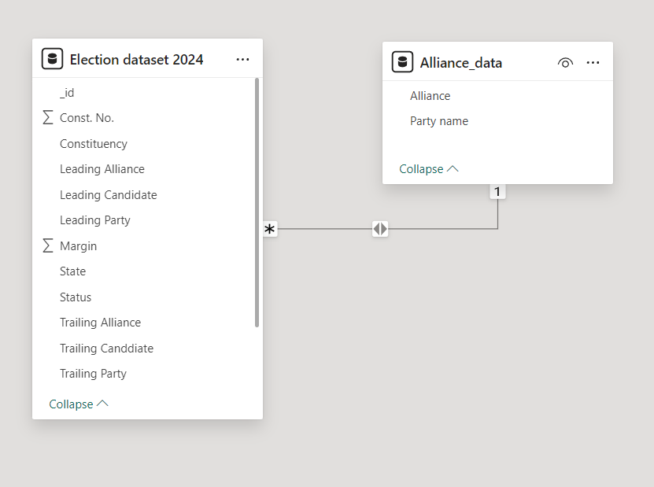
Data Integration:
Creating a relation between Leading party name and party name in Election dataset 2024 Table and Alliance data table, Respectively.
Used Merge query option in the power Query Editor and with the help of left join created a column for leading alliance and trailing alliance.

Slide 5
Data Cleaning and Preparation
In the Data, Surat Constituency from Gujarat had no trailing party. Hence the margin was in null.
Therefore, renamed the value to 0.
Corrected data type values for each fields.

Slide 6
Data Analysis and Visualization
Overall Results: summary of the overall election results including the total number of seats won by each party and alliance.
State-wise Analysis: Visualization of the performance of leading parties and alliances across different states.
Constituency-wise Analysis: Analyzing and visualizing the margin of victory/defeat in various constituencies.
Party and Alliance Comparison: Comparing the performance of different parties and their respective alliances in terms of seats won, margins, and status.
Trend Analysis: Identifying and visualizing trends in voting patterns, such as regions with high competition (small margins) or dominance by specific parties or alliances.

Slide 7
Visual Used
Table
Cards
Pie Chart
Clustered column chart
Line Chart
Line and Clustered column chart
Slicer

Slide 8
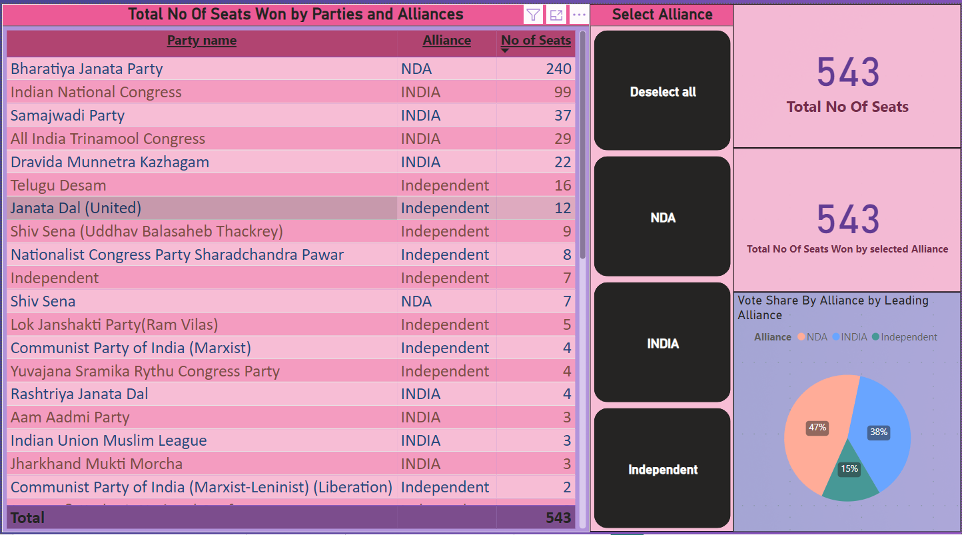
Overall Results

Slide 9
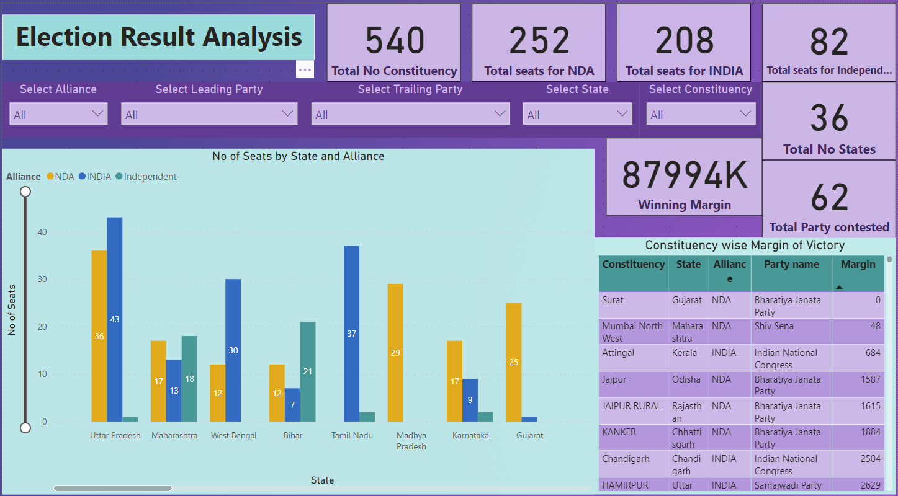
State-wise and Constituency-wise Analysis

Slide 10
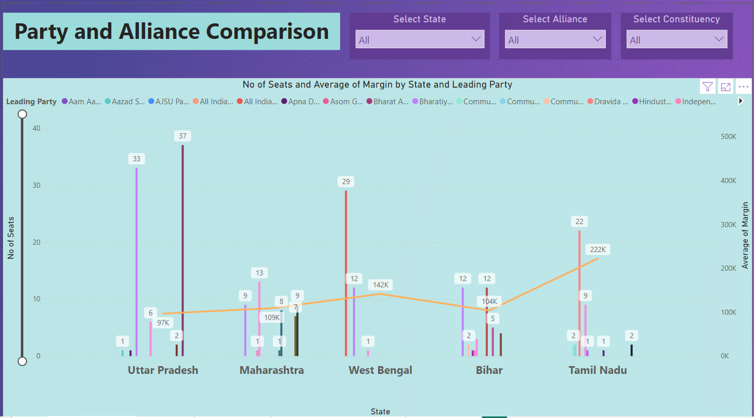
Party and Alliance Comparison

Slide 11
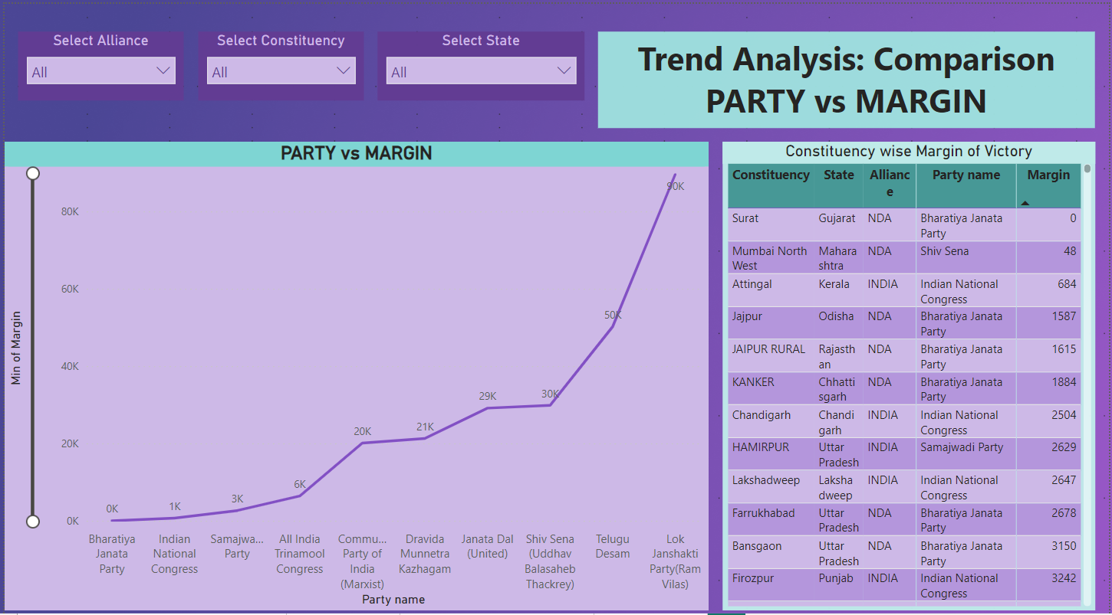
Trend Analysis

Slide 12
Insights and Recommendations:
Total No of seats is 540
62 parties Contested in the election
NDA alliance won 253 seats, with BJP in the top with 240 seats.
INDIA alliance won 208 seats, with Indian National Congress winning 99 seats.
Independent parties won 82 seats.
Indore had the highest winning margin for BJP at 1,175,092 votes.
BJP won without opposition in Surat.

Slide 13






Thank You

